Slide 1
Star Alliance.com Redesign | Fusion Workshop Results
2005

Slide 2
Table of Content: Workshop Results
Project Vision and Objectives
User Types and Use Cases
Prioritised Improvements
Front-End Benchmarks
Design Direction
Content Management System
Measurable Business Results
Roadmap and Next Steps

Slide 3
Attributes for the Project Vision
Support different languages
More interactive
Personalization (customer type-recognition)
Lively homepage
Easier navigation (find your way)
Simple site: less=more
More and better pictures
Self service
Clean pages – and garbage
Additional (accessible) travel information
Travel tools, lounge, schedule, …
Up-to-date information
Sign-up for news
Customer service, sales channel and check-in, baggage
Incentive to go to site
Frequent flyer tools + information
Travel trade support
Alliance customer-specific Star Alliance content (multi-carrier, multi-sector), e.g. Star Alliance fare products, RTW
Customer forum-community
Integrate into other sites/offers
Search engine opt.
Use for surveys

Slide 4
Project Vision
Have an interactive, customer friendly site, for multiple user groups, but with a focus on HVI Travelers
Analyzed and prioritized additional services and enhancements
Establishing Star Alliance brand + a useful, simple alliance product offering
We will build an interactive, user-friendly site for multiple user groups and focused on the HVI traveler building loyalty to the Star Alliance brand well known for providing a useful, simple Star Alliance product that delivers on our promise.
Final State-ment
"A simple, interactive, user-friendly alliance site that is truly unique."

Slide 5


Project Objectives
Objective: deliver short term STARALLIANCE.COM website enhancements with focus on:
  Redesign
  New look & feel
  Clearer navigation
  Multiple languages
  Enhance features offered (e.g. flight status information requests or Visa/Health information for respective destinations)
  Modular architecture to enable for the future evolution according to the long-term Star Alliance strategy
  Implement a scalable, maintainable, easy-to-use Content Management System that allows Star Alliance to publish content on a timely manner
This initiative will enable Star GmbH to take the lead in competitor web site presence, with this project as the first step

Slide 6
Table of Content: Workshop Results
Project Vision and Objectives
User Types and Use Cases
Prioritised Improvements
Front-End Benchmarks
Design Direction
Content Management System
Measurable Business Results
Roadmap and Next Steps

Slide 7
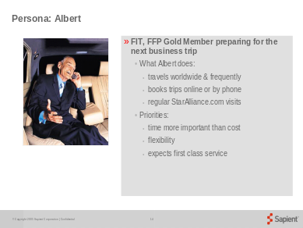
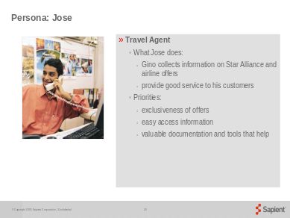
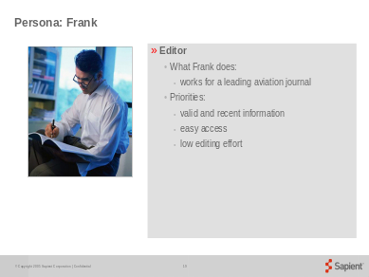
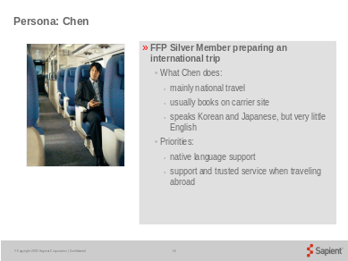
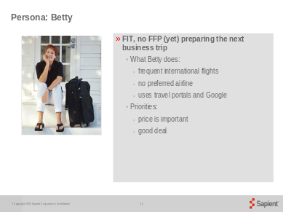
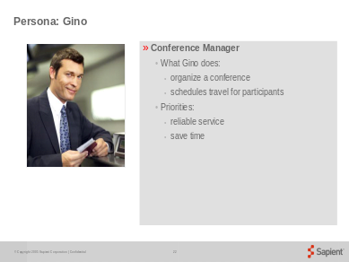
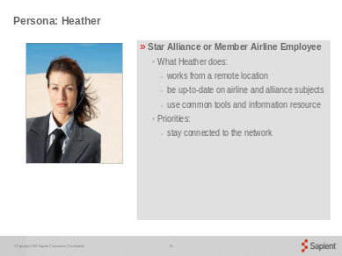
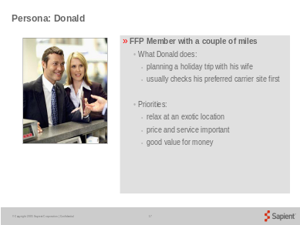
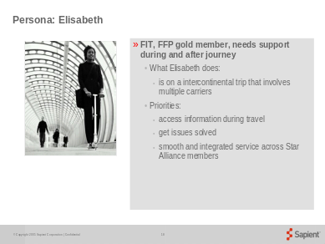
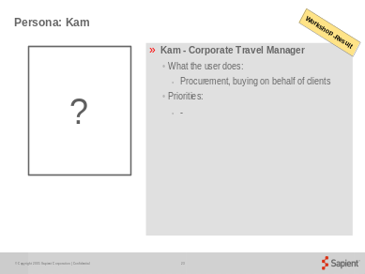
Groups of User types
Frequent International Tracveller (FIT)
Travel Trade Group
Press & Information Group
Wannabe Group
Group: Albert, Betty and Elisabeth
Votes: 9
Group: Jose, Gino and Kam
Votes: 8
Group: Frank and Heather
Votes: 6
Group: Chen and Donald
Vote: 1 (not discussed in Workshop)

Slide 8
Key Use Cases
Editor
  Add/update/delete and publish content
FIT
  View destination information
  Get flight status updates
Press & Information
  Do a full text search on all press releases
Travel Trade
  Register for the Star Alliance newsletter

Slide 9
Table of Content: Workshop Results
Project Vision and Objectives
User Types and Use Cases
Prioritised Improvements
Front-End Benchmarks
Design Direction
Content Management System
Measurable Business Results
Roadmap and Next Steps

Slide 10
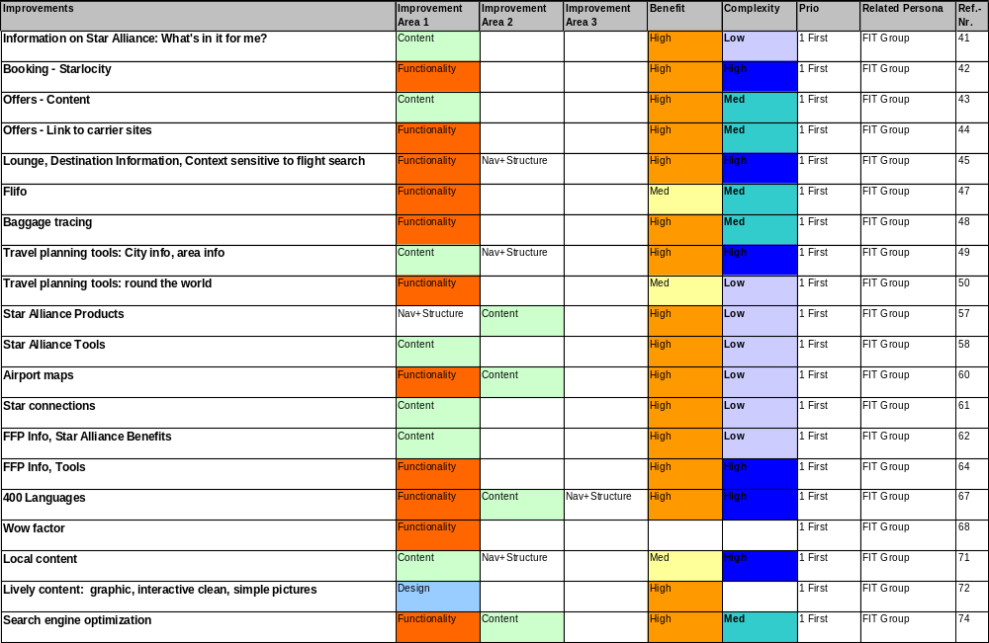
Priority 1: FIT Requirements

Slide 11
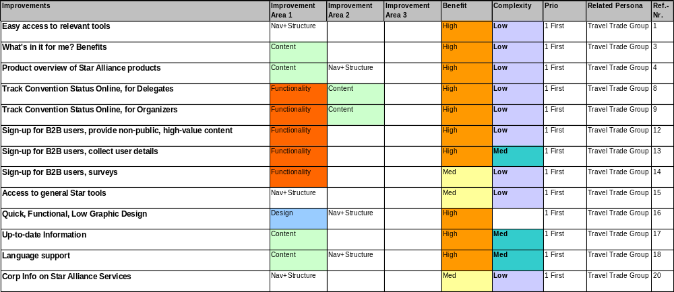
Priority 1: Travel Trade Group Requirements

Slide 12
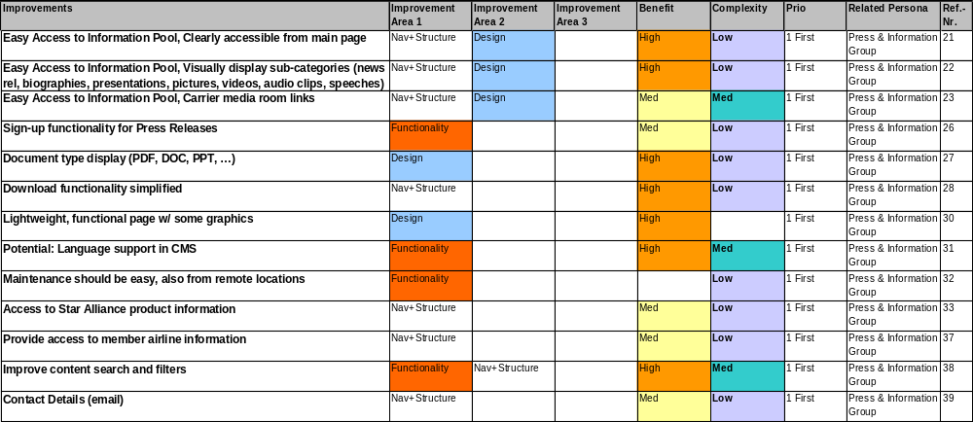
Priority 1: Press & Information Requirements

Slide 13
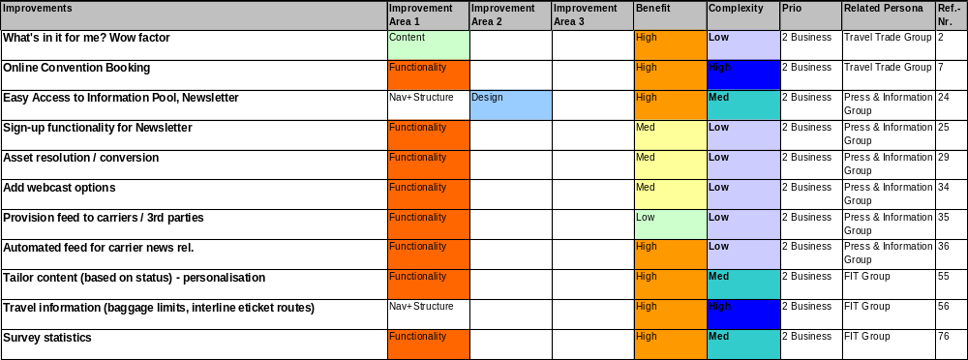
Priority 2: All groups

Slide 14
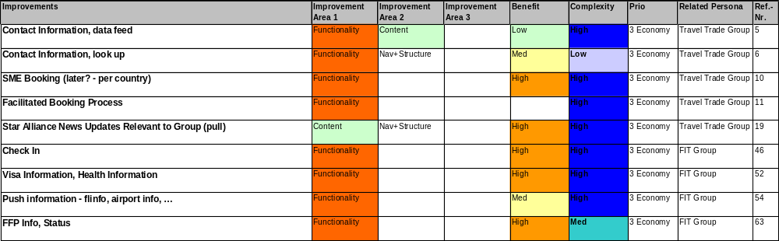
Priority 2: All groups

Slide 15
Table of Content: Workshop Results
Project Vision and Objectives
User Types and Use Cases
Prioritised Improvements
Front-End Benchmarks
Design Direction
Content Management System
Measurable Business Results
Roadmap and Next Steps

Slide 16
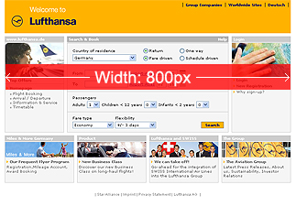
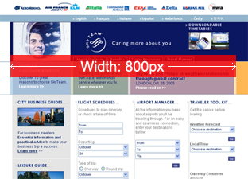
Front-End Benchmarks: Screen Resolution
General Information
  The new layout and design will be 800 x 600 pixels and centered in the page.
  Current site has two versions, one at 1024px width, the second 800px width. New site will contain one version, 800 x 600 pixels, and centered in the browser window.
    800px width is a common size for most Star Alliance Member websites:

Slide 17
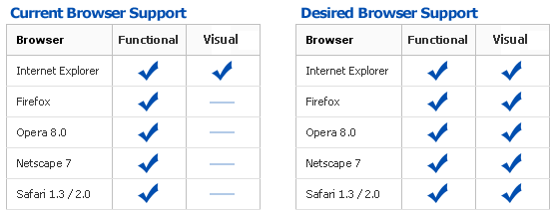
Front-End Benchmarks: Recommendations
Recommendations
  Browser support should cover multiple operating systems such as Windows, Mac OS X and Linux:
    Internet Explorer 6, Internet Explorer 5.5, Mozilla Firefox 1.x, Opera 8, Safari 1.3/2.0, Netscape 7.x
    could potentially add time and effort to testing phase

Slide 18
Table of Content: Workshop Results
Project Vision and Objectives
User Types and Use Cases
Prioritised Improvements
Front-End Benchmarks
Design Direction
Content Management System
Measurable Business Results
Roadmap and Next Steps

Slide 19
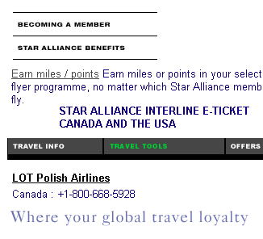
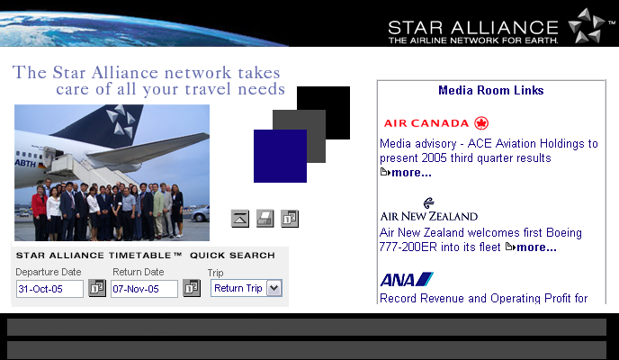
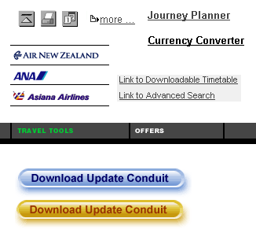
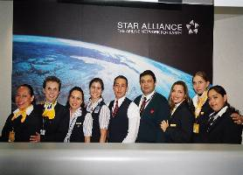
Moodboard: Look and Feel Today
Colours: black, grey and blue
Images: simple, not very expressive, conventional,
used mainly in editorial context
Type: various fonts and colours
Links/Buttons: inconsistent use of fonts and colours

Slide 20

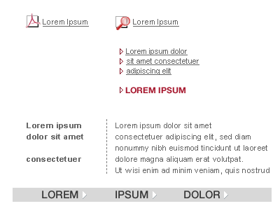
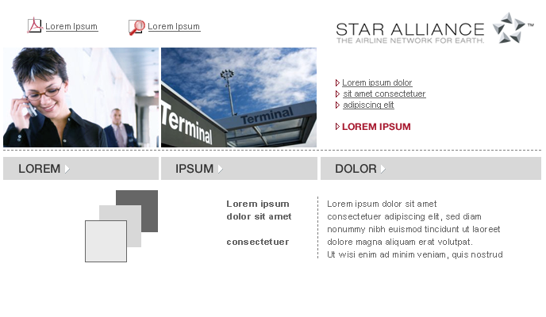
Potential Future Look and Feel - Imagery
Imagery: emotional and interesting
friendly smiling people, interesting perspective,
unusual details of images
bright and clear colours, bright light with strong contrast,
the colours should emphasize the overall colour
scheme
used as illustrative elements

Slide 21
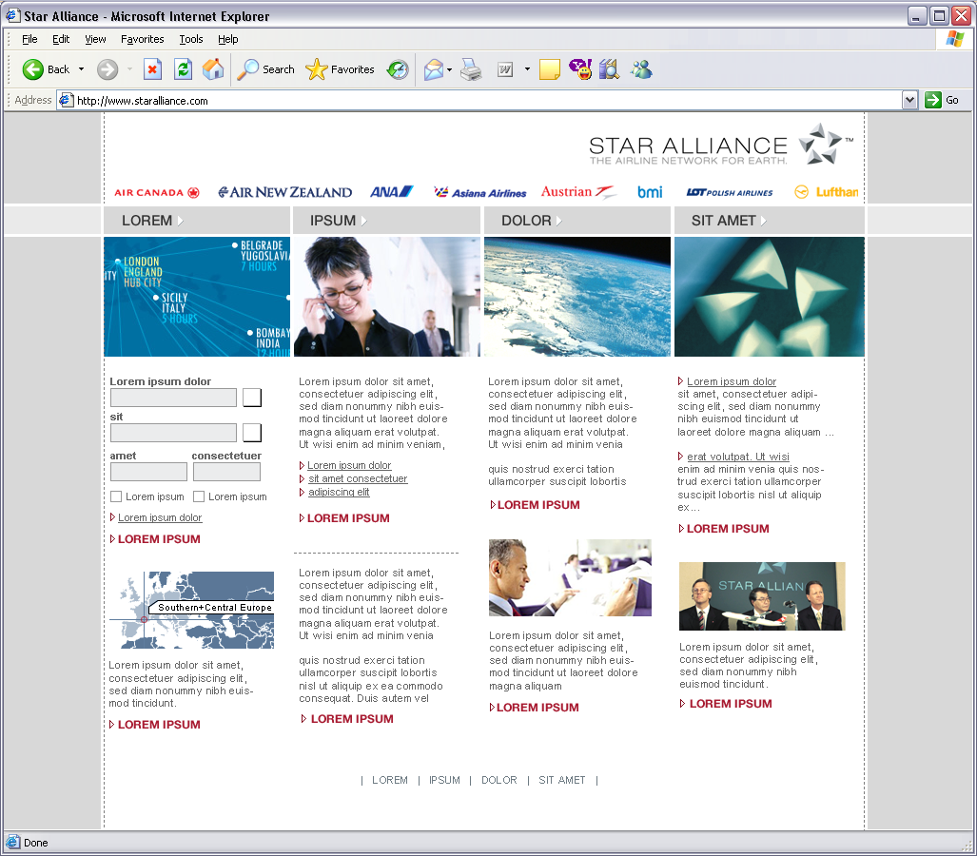
Sample Homepage

Slide 22
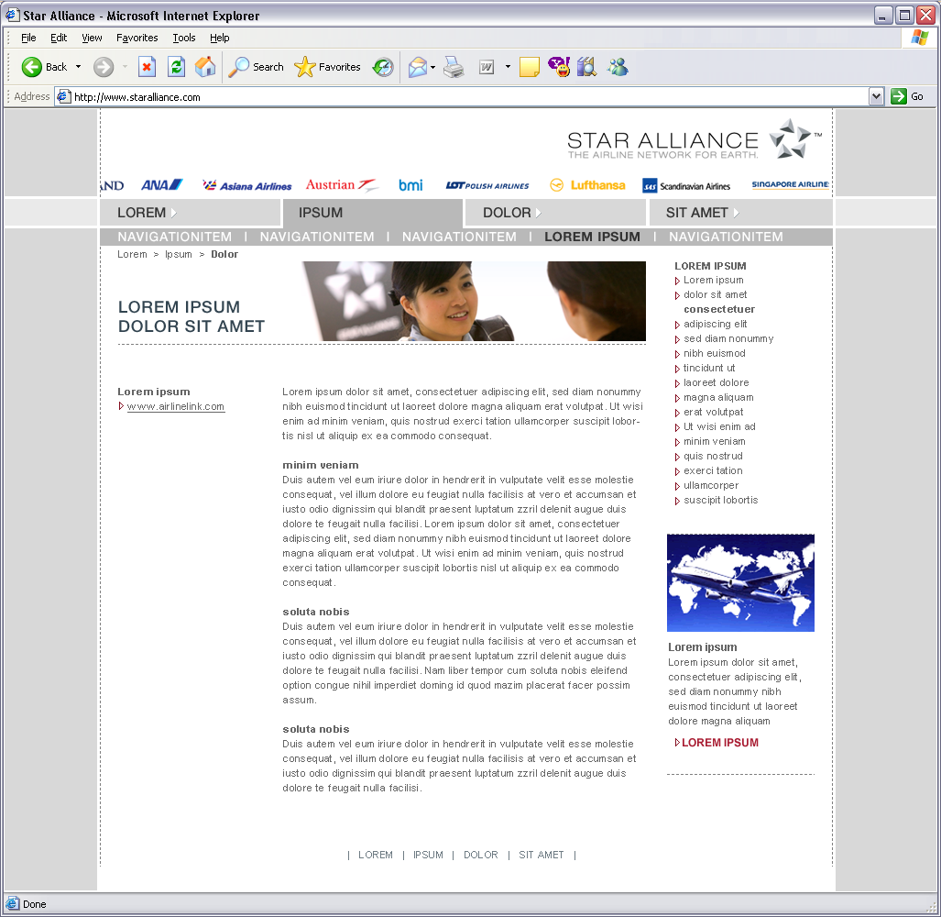
Sample Sub-Page (1)

Slide 23
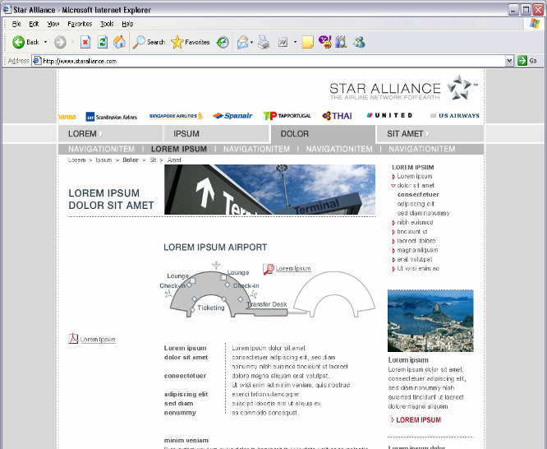
Sample Sub-Page (2)

Slide 24
Table of Content: Workshop Results
Project Vision and Objectives
User Types and Use Cases
Prioritised Improvements
Front-End Benchmarks
Design Direction
Content Management System
Measurable Business Results
Roadmap and Next Steps

Slide 25
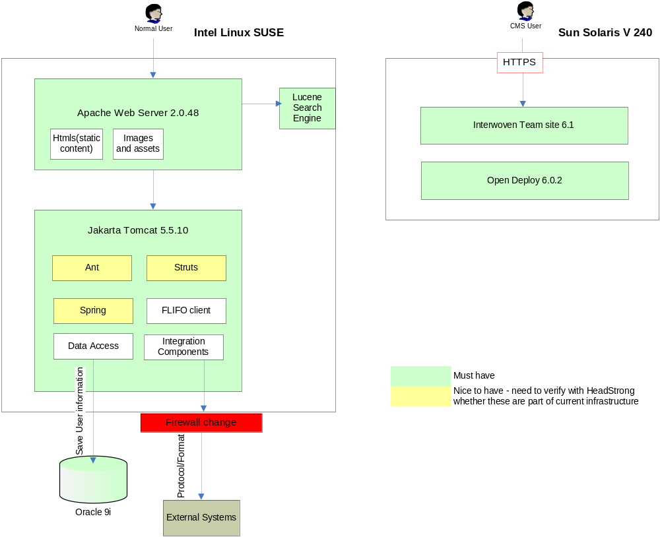
Technical Architecture

Slide 26
CMS Requirements
System response time should not exceed 8 seconds during peak time
Should be able to deal with peak time, where number of concurrent users is 1000
Maintenance of site should be simple and possible from remote locations
Keep the number of templates and modules to a minimum
Flexible content types that allows re-usage

Slide 27


Initial list of Content Types
Pages
  Lobby page
  General content page
  Related content page
  Custom page
  Anchor page
  Press release page
  Media library
Modules
  Lobby rows
  Lobby teaser
  Lobby link list
  Lobby image
  Lobby custom
  Navigation
  Meta information
  Page header
  Sections
  Link list
  Downloads
  Footer remarks
  Related content
  Promotion story teaser
  Custom module
  Related story
  Related links
  Press sections
  Image downloads
Keep the number of pages to a minimum,
ideally not more than 7 templates

Slide 28
Table of Content: Workshop Results
Project Vision and Objectives
User Types and Use Cases
Prioritised Improvements
Front-End Benchmarks
Design Direction
Content Management System
Measureable Business Results
Roadmap and Next Steps

Slide 29
Possible Measurable Business Results (MBRs)
Satisfy Airlines
Agree expectations and deliver to that
Unique hosts
Repeat visitors
Customer being transferred
- to booking (per carrier)
- to FFP join-up pages (per carrier)
- to new section per carrier
Others
Number of Tool Downloads
Increase Loyalty
RFPs for conventions received
through web
Beat oneworld / Skyteam
Customer satisfaction
Gain visibility into usage per area / topic
Deliver project on time, on budget
System performance
MBRs need to be detailed in the next project phase
Based on the current statistics a suggestion should be made for the coming phase

Slide 30
Table of Content: Workshop Results
Project Vision and Objectives
User Types and Use Cases
Prioritised Improvements
Front-End Benchmarks
Design Direction
Content Management System
Measurable Business Results
Roadmap and Next Steps

Slide 31
Approach
EAR and Release 2 – Short Term Redesign
Release 3
4 weeks
3 weeks
3 weeks
3 weeks
Iteration 1
Setup, HL Design,
POCs
Iteration 2
P1 Improvements
POCs
Iteration 3
P1 Improvements
Iteration 4
P1 Improvements
P2 Improvements
Iteration 5
P2 Improvements
P3 Improvements
Iteration n
…
Executable Architecture
Go Live Date
Visual design style guides
Content type definition and content mapping
Site structure definition
Functional specification for core site elements (e.g. navigation)
Validate the architecture by building and testing the high risk portions (POCs)
Develop key artifacts (system architecture diagrams, data models and interface specifications)

Slide 32
Next Steps
What?
Who?
When?
Site Structure and Design Parameters
HL Effort estimate for P1/P2 (incl. assumptions & dependencies)
Finalize agreed scope
Summarize previous work and send to group
Define core team
AMB update
Provide revised plan based on final scope
Create RFP
Star Alliance website strategy
Daniel
Dirk
Dave
Mark
Dave
Mark
Stefan
Dave/Mark
Stefan
8/11
11/11
16/11
11/11
11/11
16/11
18/11
tbd
asap

Slide 33

Thank You!

